Slide 1
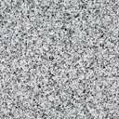
100 cm depth
seine net
transect marker

